Slide 1
GEOG0125
Advanced Topics in Social and Geographic Data Science
BAYESIAN HIERARCHICAL REGRESSION models
Dr Anwar Musah (a.musah@ucl.ac.uk)
Lecturer in Social and Geographic Data Science
UCL Geography
1

Slide 2
Contents
Problem
What are Hierarchical Regression Models?
Usage for exploring relationships with complex data structures (hierarchies, nesting, repeated measures, temporality etc.,)
Importance and why we use them to account for a specific data artefact
Wide applications of this specialized technique to other scientific domains
Components of a hierarchical model
Statistical formulation
Random intercepts and Random slopes
Model types: Intercept-only, Random slope-only or both
Model Specification from a Bayesian Framework
Examples and interpretation
Knowledge
Collect
Model
Wrangle
Explore
2

Slide 3
What are Hierarchical Regression Models?
3

Slide 4
Recall in Week 2 and 3, we have extensively covered these various types of regression models
Distribution of dependent variable | Suitable Model (GLM or GAM)
Continuous measures: e.g., average income in postcode (£); concentrations of ambient particular matter (PM2.5); Normalised Vegetative Difference Index (NDVI) etc., | Linear regression
Binary measures (1 = “present” or 0 = “absent”): e.g., Person’s voting for a candidate, Lung cancer risk, house infested with rodents etc., | Logistic Regression
Binomial measure (or proportion): e.g., prevalence of houses in a postcode infested with rodents, percentage of people in a village infected with intestinal parasitic worms, prevalence of household on a street segment victimised by crime etc., | Logistic Regression
Counts or discrete measures: e.g., number of reported burglaries on a street segment, number of riots in a county etc., | Poisson Regression
Note 1: The models listed in this table assumes there is a “linear” relationship between the outcome and some independent variable(s).
These models are typically used within a generalised linear modelling framework.
Note 2: The models listed in this table have alternative versions; when the relationship between the outcome and some independent variable(s) are “non-linear”, they can be used within a generalised additive modelling framework.
Typically, the data structure or scenario we have been applying these models to are single row records or unit observations (i.e., for an individual, or a geographical unit etc.,)
What about data structures with repeated measurements, or unit observation within a group, or temporal datasets?
4

Slide 5
Data structures [1]
Imagine we have some dataset containing information on an individual-level.
ID | Name | Maths Performance | Maths TSR | OFSTED Grade
SCH01 | Acton High School | 29 | 20.9 | 5 (Worst)
SCH02 | Brentside High School | 40 | 18.6 | 5 (Worst)
SCH03 | Greenford High School | 51 | 11.7 | 3 (Below average)
SCH04 | Northolt High School | 60 | 9.9 | 2 (Good)
SCH05 | Ellen Wilkinson School | 88 | 14.6 | 0 (Excellent)
SCH06 | Twyford Church of England | 76 | 6.3 | 1 (Very Good)
SCH07 | Featherstone High School | 73 | 5.3 | 1 (Very Good)
SCH08 | Drayton Manor High School | 80 | 12.9 | 0 (Excellent)
SCH09 | Dormers Wells High School | 67 | 16.5 | 2 (Good)
Note 1: This dataset contain details for individual schools in Ealing Borough (inside London). Information on the overall maths performance of a school and the maths teacher-student ratio in a class.
We want to understand what historical and sociodemographic factors have an impact on a school’s performance when it comes to mathematics.
Note 2: We would typically fit a linear regression model if we wanted to see how just Maths TSR and OFSTED Grade are linked with Maths Performance variable.
5

Slide 6
Data structures [2]
Suppose we want to consider broader risk factors, not measured at an individual-level but at a group-level…
ID | LSOA | Name | Maths Performance | Maths TSR | OFSTED Grade | LSOA IMD Resources | LSOA IMD Income
SCH01 | LSOA01 | Acton High School*** | 29 | 20.9 | 5 (Worst) | 5.2305 | 6.4734
SCH02 | LSOA01 | Brentside High School | 40 | 18.6 | 5 (Worst) | 5.2305 | 6.4734
SCH03 | LSOA01 | Greenford High School | 51 | 11.7 | 3 (Below average) | 5.2305 | 6.4734
SCH04 | LSOA02 | Northolt High School | 60 | 9.9 | 2 (Good) | 1.2353 | 0.3491
SCH05 | LSOA02 | Ellen Wilkinson School | 88 | 14.6 | 0 (Excellent) | 1.2353 | 0.3491
SCH06 | LSOA03 | Twyford Church of England | 76 | 6.3 | 1 (Very Good) | 0.2396 | 1.9843
SCH07 | LSOA03 | Featherstone High School | 73 | 5.3 | 1 (Very Good) | 0.2396 | 1.9843
SCH08 | LSOA03 | Drayton Manor High School | 80 | 12.9 | 0 (Excellent) | 0.2396 | 1.9843
SCH09 | LSOA04 | Dormers Wells High School | 67 | 16.5 | 2 (Good) | 3.1435 | 2.3679
For instance, other broader factors that might either be on an environmental, geopolitical, societal-level e.g., LSOA IMD public resource allocation for schools and average income scores. We have altered the structure of our dataset and made it far more complex…
6

Slide 7
Data structures [3]
A hierarchical or multi-level structure in the dataset is formed
ID | LSOA | Name | Maths Performance | Maths TSR | OFSTED Grade | LSOA IMD Resources | LSOA IMD Income
SCH01 | LSOA01 | Acton High School*** | 29 | 20.9 | 5 (Worst) | 5.2305 | 6.4734
SCH02 | LSOA01 | Brentside High School | 40 | 18.6 | 5 (Worst) | 5.2305 | 6.4734
SCH03 | LSOA01 | Greenford High School | 51 | 11.7 | 3 (Below average) | 5.2305 | 6.4734
SCH04 | LSOA02 | Northolt High School | 60 | 9.9 | 2 (Good) | 1.2353 | 0.3491
SCH05 | LSOA02 | Ellen Wilkinson School | 88 | 14.6 | 0 (Excellent) | 1.2353 | 0.3491
SCH06 | LSOA03 | Twyford Church of England | 76 | 6.3 | 1 (Very Good) | 0.2396 | 1.9843
SCH07 | LSOA03 | Featherstone High School | 73 | 5.3 | 1 (Very Good) | 0.2396 | 1.9843
SCH08 | LSOA03 | Drayton Manor High School | 80 | 12.9 | 0 (Excellent) | 0.2396 | 1.9843
SCH09 | LSOA04 | Dormers Wells High School | 67 | 16.5 | 2 (Good) | 3.1435 | 2.3679
We have 9 records but we created an hierarchy…
3 school records nested in LSOA01;
2 school records nested in LSOA02;
3 school records nested in LSOA03;
1 school record nested in LSOA04
7

Slide 8
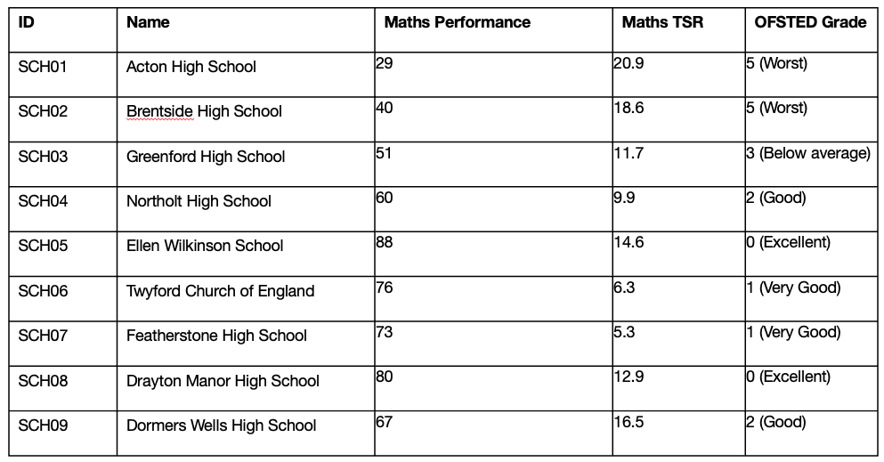
Data structures [4]
Individual-level data
Group-level data
LSOA | LSOA IMD Resources | LSOA IMD Income
LSOA01 | 5.2305 | 6.4734
LSOA02 | 1.2353 | 0.3491
LSOA03 | 0.2396 | 1.9843
LSOA04 | 3.1435 | 2.3679
We have 9 records but we created an hierarchy…
3 school records nested in LSOA01;
2 school records nested in LSOA02;
3 school records nested in LSOA03;
1 school record nested in LSOA04
A typical linear regression model would be severely inadequate for this problem due to the hierarchical structure that is formed in this dataset.
We would need a model that not only takes into account how the records are nested within a group; but one that would allow us to model the “within-group” variations formed in each group, as well as the “across-group” variations. Lastly, we will need a model that will let us fitted both individual-level and group-level variables, this is called a hierarchical regression model.
8

Slide 9
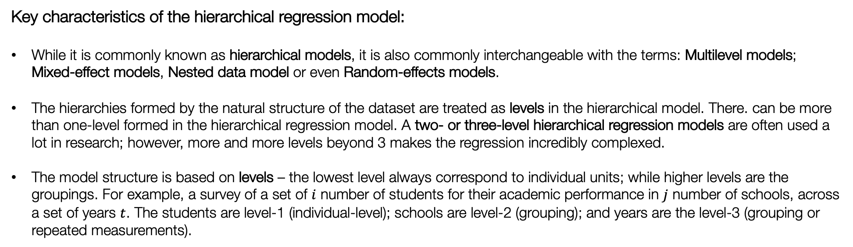
Definition:
A hierarchical regression model, are a specialised group of regression-based models that are able to recognise the existence of hierarchies within a data structure and account for them. It is a statistical model used for exploring the relationship between a dependent variable with one or more independent variables while accounting for these hierarchical structures.
Key characteristics of the hierarchical regression model:
While it is commonly known as hierarchical models, it is also commonly interchangeable with the terms: Multilevel models; Mixed-effect models, Nested data model or even Random-effects models.
The hierarchies formed by the natural structure of the dataset are treated as levels in the hierarchical model. There. can be more than one-level formed in the hierarchical regression model. A two- or three-level hierarchical regression models are often used a lot in research; however, more and more levels beyond 3 makes the regression incredibly complexed.
The model structure is based on levels – the lowest level always correspond to individual units; while higher levels are the groupings. For example, a survey of a set of $i$ number of students for their academic performance in $j$ number of schools, across a set of years $t$. The students are level-1 (individual-level); schools are level-2 (grouping); and years are the level-3 (grouping or repeated measurements).
9

Slide 10








We are Illustrating concisely what we mean by two- or three-level model structure [1]
School information (level-2)
School 1
School 2
School 3
School $j$
$$⋯$$
1
2
3
$$⋯$$
$$i$$
1
2
3
$$⋯$$
$$i$$
1
2
3
$$⋯$$
$$i$$
1
2
3
$$⋯$$
$$i$$
Student information (level-1)
Notes: We have individual units of information that are nested or grouped within a higher measure. This is typically a two-level structure and a two-level hierarchical regression model must be used for this scenario.
Building on the example highlighted in point 3 (see slide 9): A survey of a set of $i$ number of students for their academic performance in $j$ number of schools, across a set of years $t$. The students are level-1 (individual-level); schools are level-2 (grouping); and years are the level-3 (grouping or repeated measurements).
10

Slide 11
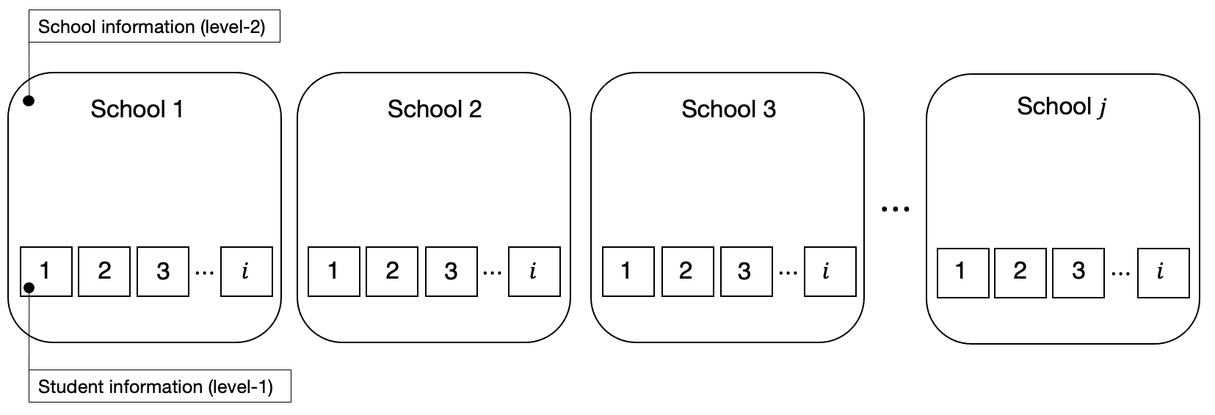

We are Illustrating concisely what we mean by two- or three-level model structure [2]
Temporal information (level-3)
Time 1
Time 2
Time 3
$$⋯$$
Notes: We have individual units of information that are nested or grouped within a higher measure, where by the same individuals (from the same units) are repeated (i.e., longitudinal). This is typically a three-level structure and so a three-level hierarchical regression model must be used for this scenario.
Building on the example highlighted in point 3 (see slide 9): A survey of a set of $i$ number of students for their academic performance in $j$ number of schools, across a set of years $t$. The students are level-1 (individual-level); schools are level-2 (grouping); and years are the level-3 (grouping or repeated measurements).
11
Notes:
Illustrate what these hierarchies are – and then go into why they are important in next slide

Slide 12
Definition:
A hierarchical regression model, are a specialised group of regression-based models that are able to recognise the existence of hierarchies within a data structure and account for them. It is a statistical model used for exploring the relationship between a dependent variable with one or more independent variables while accounting for these hierarchical structures.
Why are hierarchical regression models important:
It is an elegant way to model datasets that have varying scales in their measurements ( - this artefact is caused by the multilevel or hierarchical structure in the dataset)
It is an robust approach for accounting for variations across individual units, and at the same time, the “within-group variations” among groupings
When we are modelling the direct relationship between the level-1 independent variables against the dependent variable, we can allow for direct interactions between level-1 and higher level independent variables that were measured at a group-level
We can quantify group-specific differences as well as group-specific coefficients through the usage of “varying-slopes” or “varying-coefficients”
12

Slide 13
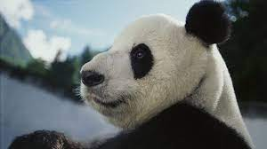



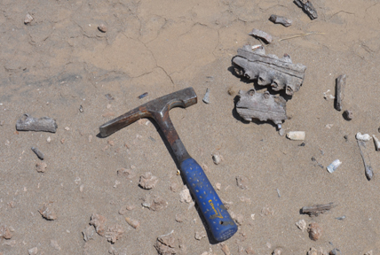
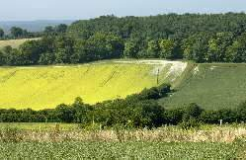
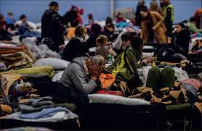
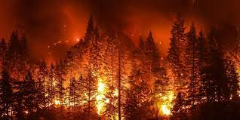
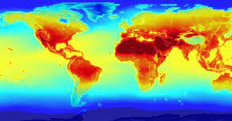
Zoology
Food security
Environmental Criminology
Environmental & Spatial Epidemiology
Vector-borne disease
Palaeontogy and Archology
Landscape ecology
Natural Disaster Science
Climate
Humanitarian crisis
13
Notes:
Application is quite massive in nearly all scientific domains and in other realms of research.

Slide 14
Components of a Hierarchical Regression Model
14

Slide 15
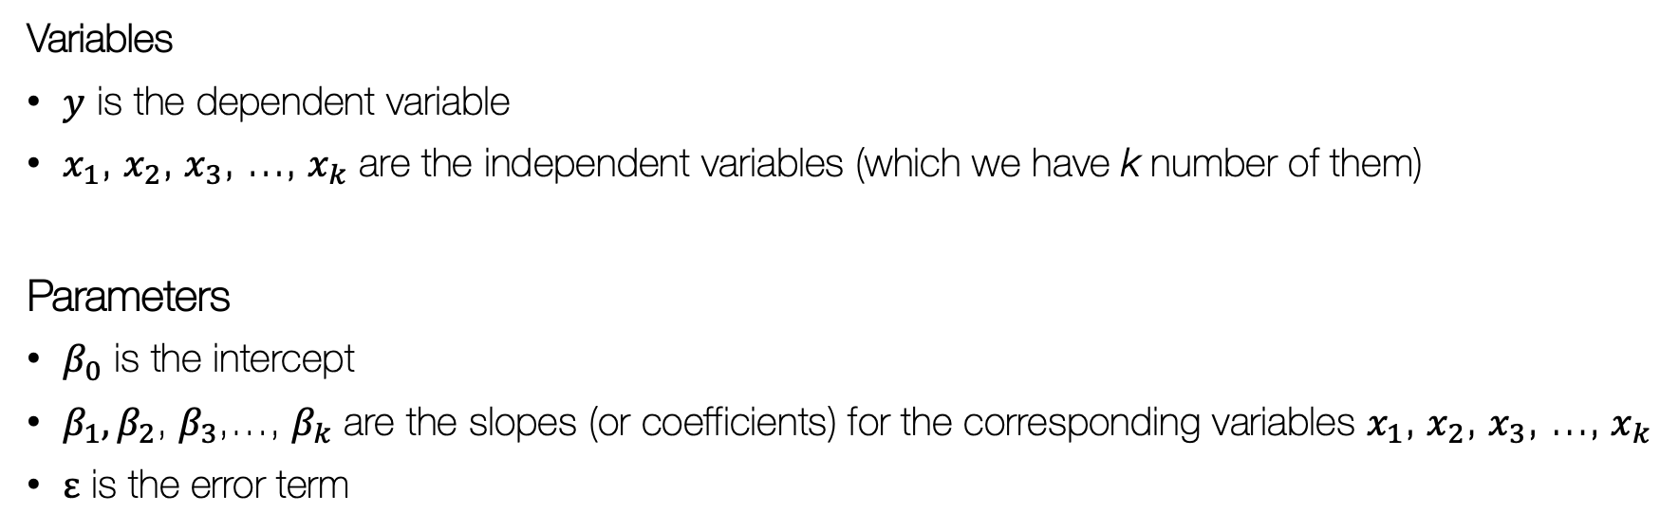
Recall the base model formula for a GLM
$$y= β_{0}+β_{1}x_{1}+β_{2}x_{2}+…+ε$$
See Week 2 and 3 notes
Variables
$y$ is the dependent variable
$x_{1}$, $x_{2}$, $x_{3}$, …, $x_{k}$ are the independent variables (which we have k number of them)
Parameters
$β_{0}$ is the intercept
$β_{1},β_{2}$, $β_{3}$,…, $β_{k}$ are the slopes (or coefficients) for the corresponding variables $x_{1}$, $x_{2}$, $x_{3}$, …, $x_{k}$
$ε$ is the error term
Let’s extend the above model into a hierarchical framework
15

Slide 16
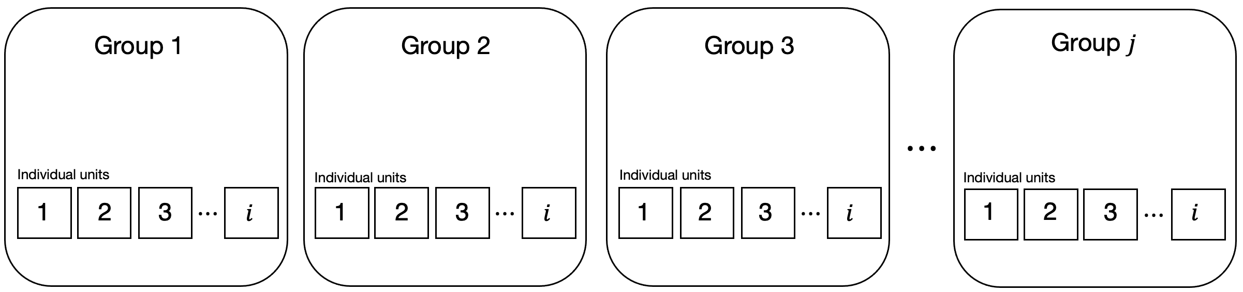
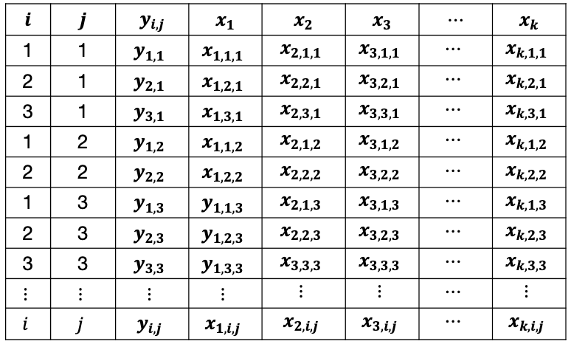
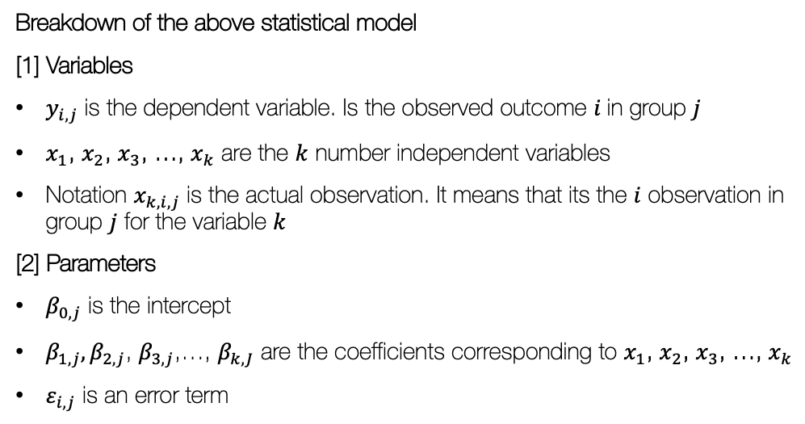
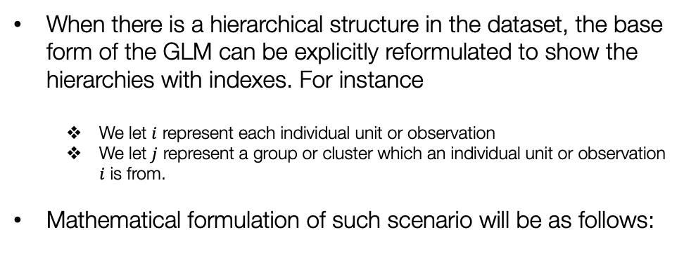
Mathematical reformulation of the base GLM regression model using indexes
When there is a hierarchical structure in the dataset, the base form of the GLM can be explicitly reformulated to show the hierarchies with indexes. For instance
We let $i$ represent each individual unit or observation
We let $j$ represent a group or cluster which an individual unit or observation $i$ is from.
Mathematical formulation of such scenario will be as follows:
2-level hierarchical data drawn in picture form
$$y_{i,j}= β_{0,j}+β_{1,j}x_{1,i,j}+β_{2,j}x_{2,i,j}+…+β_{k,j}x_{k,i,j}+ε_{i,j}$$
2-level hierarchical data frame written in matrix algebraic form
Breakdown of the above statistical model
[1] Variables
$y_{i,j}$ is the dependent variable. Is the observed outcome $i$in group $j$
$x_{1}$, $x_{2}$, $x_{3}$, …, $x_{k}$ are the $k$ number independent variables
Notation $x_{k, i,j}$ is the actual observation. It means that its the $i$ observation in group $j$ for the variable $k$
[2] Parameters
$β_{0,j}$ is the intercept
$β_{1,j},β_{2,j}$, $β_{3,j}$,…, $β_{k,J}$ are the coefficients corresponding to $x_{1}$, $x_{2}$, $x_{3}$, …, $x_{k}$
$ε_{i,j}$ is an error term
16
Notes:
Wondering

Slide 17
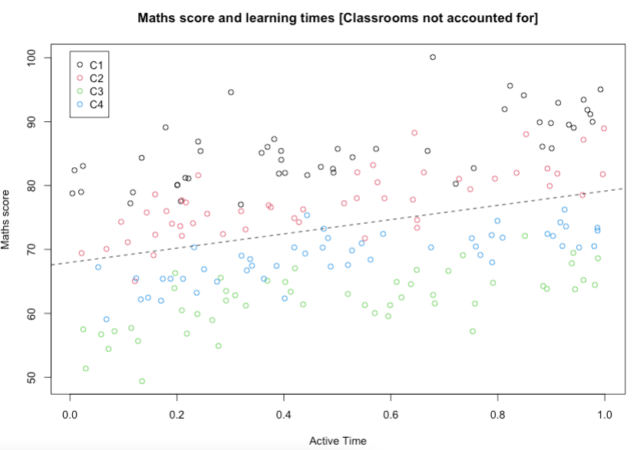
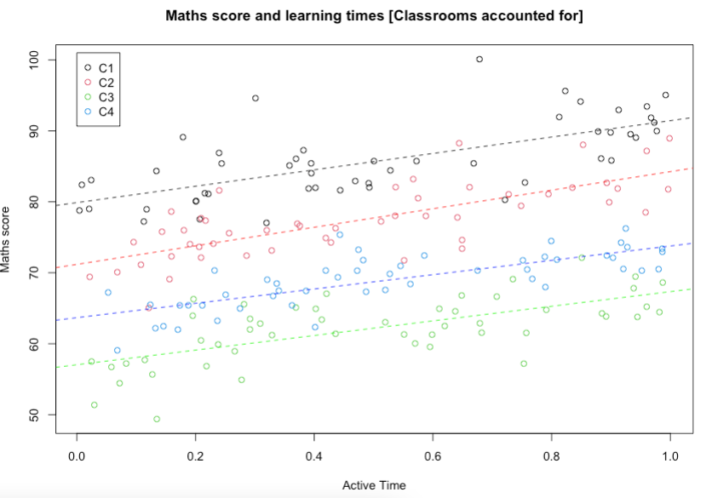






Notation for the intercept and coefficient i.e., $β_{0,j}$ and $β_{k,j}$ - what are they?
Let us consider the following scenarios: 50 students in 4 classes, we are interested to know how active learning time impacts maths score
GLM model (not-indexed)
GLM model (indexed)
$$y= β_{0}+β_{1}x_{1}+β_{2}x_{2}+…+β_{k}x_{k}+ε$$
$$y_{i,j}= β_{0,j}+β_{1,j}x_{1,i,j}+β_{2,j}x_{2,i,j}+…+β_{k,j}x_{k,i,j}+ε_{i,j}$$
$$β_{0}=67.971$$
$$β_{1}=11.167$$
$$β_{0,1}=79.88,{ β}_{1,1}=11.551$$
$$β_{0,3}=57.03,β_{1,3}=10.299$$
$$β_{0,2}=71.17,{ β}_{1,2}=13.073$$
$$β_{0,4}=63.67,β_{1,4}=10.101$$
Here, we can see that if we use a statistical model analyse this data without regards for the group structure. We get a single intercept and a single coefficient. Here, we are assuming that this relationship between active times and maths are similar across all the 200 students regardless of the classrooms they are in. This is what we term as Fixed Effects scenario
However, we can see that this panel shows something different. Accounting for the classroom groups, by fitting separate linear models we get different intercepts (i.e., global mean) with different slope (or slope variation). There is an indication that some variation within the groups that’s causing this pattern. This variation is known as a Random Effects, and it acting on our intercepts and slopes. This random effect must be accounted for, and so doing this would mean reformulated indexed model with the random effects into a true hierarchical equation!
17

Slide 18
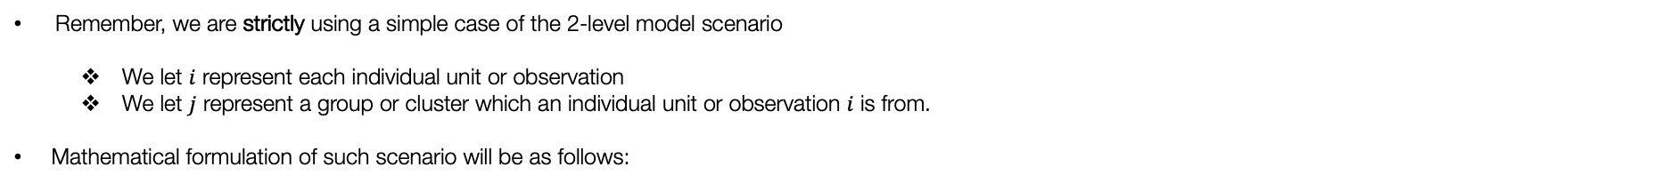


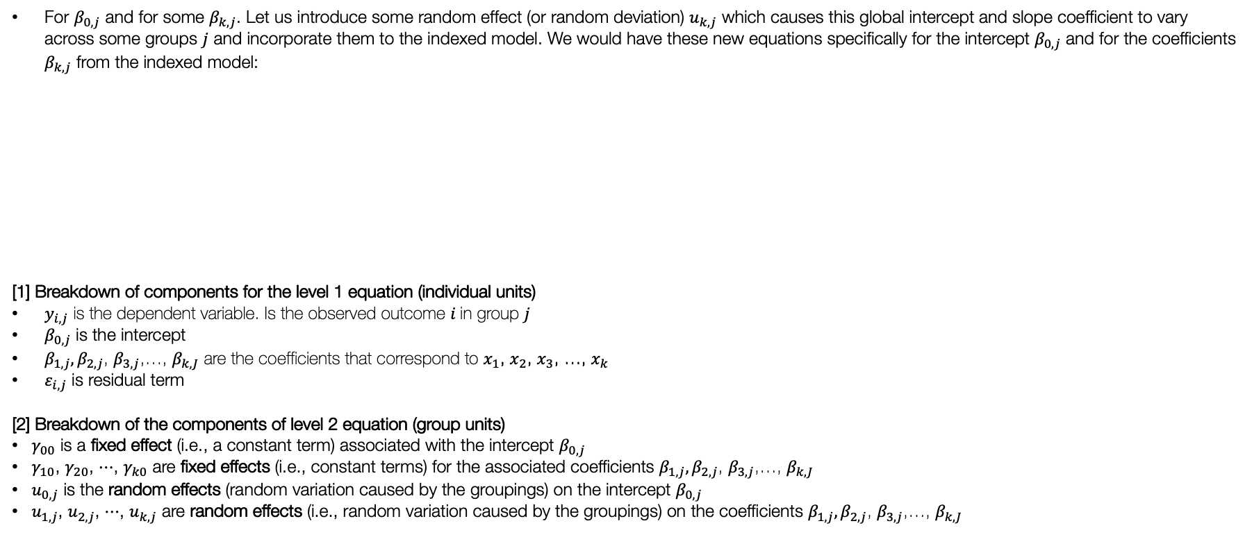
Mathematical formulation for hierarchical regression model (full form) [1]
Remember, we are strictly using a simple case of the 2-level model scenario
We let $i$ represent each individual unit or observation
We let $j$ represent a group or cluster which an individual unit or observation $i$ is from.
Mathematical formulation of such scenario will be as follows:
$$y_{i,j}= β_{0,j}+β_{1,j}x_{1,i,j}+β_{2,j}x_{2,i,j}+…+β_{k,j}x_{k,i,j}+ε_{i,j}$$
Level 1 Equation
For $β_{0,j}$ and for some $β_{k,j}$. Let us introduce some random effect (or random deviation) $u_{k,j}$ which causes this global intercept and slope coefficient to vary across some groups $j$ and incorporate them to the indexed model. We would have these new equations specifically for the intercept $β_{0,j}$ and for the coefficients $β_{k,j}$ from the indexed model:
[1] Breakdown of components for the level 1 equation (individual units)
$y_{i,j}$ is the dependent variable. Is the observed outcome $i$in group $j$
$β_{0,j}$ is the intercept
$β_{1,j},β_{2,j}$, $β_{3,j}$,…, $β_{k,J}$ are the coefficients that correspond to $x_{1}$, $x_{2}$, $x_{3}$, …, $x_{k}$
$ε_{i,j}$ is residual term
[2] Breakdown of the components of level 2 equation (group units)
$γ_{00}$ is a fixed effect (i.e., a constant term) associated with the intercept $β_{0,j}$
$γ_{10}$, $γ_{20}$, $⋯$, $γ_{k0}$ are fixed effects (i.e., constant terms) for the associated coefficients $β_{1,j},β_{2,j}$, $β_{3,j}$,…, $β_{k,J}$
$u_{0,j}$ is the random effects (random variation caused by the groupings) on the intercept $β_{0,j}$
$u_{1,j}$, $u_{2,j}$, $⋯$, $u_{k,j}$ are random effects (i.e., random variation caused by the groupings) on the coefficients $β_{1,j},β_{2,j}$, $β_{3,j}$,…, $β_{k,J}$
$$β_{0,j}= γ_{00}+u_{0,j}$$
$$β_{1,j}=γ_{10}+u_{1,j}$$
$$β_{2,j}=γ_{20}+u_{2,j}$$
$$β_{k,j}=γ_{k0}+u_{k,j}$$
Note 1: The above level 1 equation is a normal regression that we know. We makes it a hierarchical regression model is when we incorporate these random effects by nesting these level 2 equations to the intercept and coefficients in the level 1 equation.
Level 2 Equations
$$⋮$$
$$⋮$$
$$⋮$$
Note 2: Notice how the intercept and slopes in level 1 equation are indeed a function of the components of the level 2 counterparts? To get the hierarchical regression in its full form, we simply substitute the level 2 equation into level 1
18

Slide 19
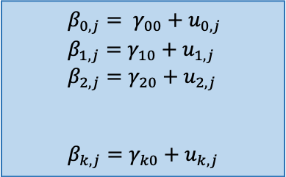

Mathematical formulation for hierarchical regression model (full form) [2]
$$y_{i,j}= β_{0,j}+β_{1,j}x_{1,i,j}+β_{2,j}x_{2,i,j}+…+β_{k,j}x_{k,i,j}+ε_{i,j}$$
Level 1 Equation
$$β_{0,j}= γ_{00}+u_{0,j}$$
$$β_{1,j}=γ_{10}+u_{1,j}$$
$$β_{2,j}=γ_{20}+u_{2,j}$$
$$β_{k,j}=γ_{k0}+u_{k,j}$$
1st equation is a random-intercept
2nd, 3rd and 4th and so on equations are random-slopes
Level 2 Equations
$$⋮$$
$$⋮$$
$$⋮$$
Note that these equation does not have a two-level independent variable that impacts the outcome
Substitute the level 2 model equations into the level 1 model equation:
$$⇒y_{i,j}=\left(γ_{00}+u_{0,j}\right)+(γ_{10}+u_{1,j})x_{1,i,j}+(γ_{20}+u_{2,j})x_{2,i,j}+…+(γ_{k0}+u_{1,j})x_{k,i,j}+ε_{i,j}$$
After substitution, we expanding the expression and rearrange as follows:
${⇒y}_{i,j} =$ $γ_{00}+γ_{10}x_{1,i,j}+γ_{20}x_{2,i,j}+…+γ_{k0}x_{k,i,j}+$ $u_{0,j}+u_{1,j}x_{1,i,j}+u_{2,j}x_{2,i,j}+…+u_{k,j}x_{k,i,j}+ε_{i,j}$
Model’s true form
Fixed part
Random part
Note: There are model scenarios
$γ_{00}$ is the global intercept from the fixed part of the model we want to report
$γ_{10}, γ_{20}, …and γ_{k0}$ are the coefficients from the fixed part of the model we want to report now
$u_{0,j}, u_{1,j}, u_{2,j}, …and u_{k,j}$ as well as $ε_{i,j}$they have variances for random part of the model we want to report
19

Slide 20


Random-intercept-only, Random-slopes & Random coefficient scenarios [1]
$$y_{i,j}= β_{0,j}+β_{1,j}x_{1,i,j}+β_{2,j}x_{2,i,j}+…+β_{k,j}x_{k,i,j}+ε_{i,j}$$
Level 1 Equation
This is an example of a random-slope model which includes both a random-intercept and random-slopes. This means there group structures causes variation in the means across groups (i.e., intercepts) and slopes
$$β_{0,j}= γ_{00}+u_{0,j}$$
$$β_{1,j}=γ_{10}+u_{1,j}$$
$$β_{2,j}=γ_{20}+u_{2,j}$$
$$β_{k,j}=γ_{k0}+u_{k,j}$$
Level 2 Equations
$$⋮$$
$$⋮$$
$$⋮$$
$y_{i,j} =$ $γ_{00}+γ_{10}x_{1,i,j}+γ_{20}x_{2,i,j}+…+γ_{k0}x_{k,i,j}+$ $u_{0,j}+u_{1,j}x_{1,i,j}+u_{2,j}x_{2,i,j}+…+u_{k,j}x_{k,i,j}+ε_{i,j}$
Model’s true form
Group 2
Fixed part
Random part
Group 1
Group 3
Group 4
20

Slide 21

Random-intercept-only, Random-slopes & Random coefficient scenarios [2]
$$y_{i,j}= β_{0,j}+β_{1,j}x_{1,i,j}+β_{2,j}x_{2,i,j}+…+β_{k,j}x_{k,i,j}+ε_{i,j}$$
Level 1 Equation
$$β_{0,j}= γ_{00}+u_{0,j}$$
Level 2 Equation
This is an example of a random-intercept-only model which only includes a random-intercept and excludes the random-slopes. This means that the group structure causes variation on the means (i.e., group-specific intercepts) but not on slopes
Here, the model is much simpler:
$y_{i,j} =$ $γ_{00}+β_{1,j}x_{1,i,j}+β_{2,j}x_{2,i,j}+…+β_{k,j}x_{k,i,j}{+ u}_{0,j}+ ε_{i,j}$
Model’s true form
Fixed part
Random part
Group 1
Group 2
Group 3
Group 4
21

Slide 22



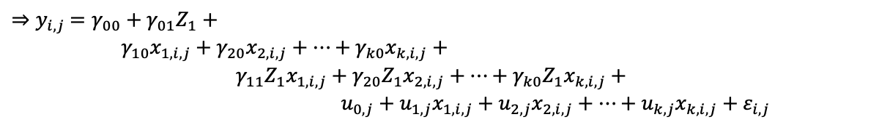

Random-intercept-only, Random-slopes & Random coefficient scenarios [1]
$$y_{i,j}= β_{0,j}+β_{1,j}x_{1,i,j}+β_{2,j}x_{2,i,j}+…+β_{k,j}x_{k,i,j}+ε_{i,j}$$
Level 1 Equation
$${ β}_{0,j} = γ_{00}+{γ_{01}Z_{1}+u}_{0,j}$$
$$β_{1,j}=γ_{10}+γ_{11}Z_{1}+u_{1,j}$$
$$β_{2,j}=γ_{20}+γ_{21}Z_{1}+u_{2,j}$$
$$β_{k,j}=γ_{k0}+γ_{k1}Z_{1}+u_{k,j}$$
Suppose we have an independent variable measure on the group-level impacting our outcome on the individual-level.
Level 2 Equations
$$⋮$$
$$⋮$$
$$⋮$$
$$⋮$$
Substitute the level 2 model equations with the variables into the level 1 model equation:
$$⇒y_{i,j}=\left(γ_{00}+{γ_{01}Z}_{I}+{ u}_{0,j}\right)+(γ_{10}+{γ_{11}Z}_{I}+u_{1,j})x_{1,i,j}+(γ_{20}+{γ_{21}Z}_{I}+u_{2,j})x_{2,i,j}+…+(γ_{k0}+{γ_{k1}Z}_{I}+u_{1,j})x_{k,i,j}+ε_{i,j}$$
After substitution, we expanding the expression and rearrange as follows:
$γ_{00}$ is the global or population mean
${⇒y}_{i,j} =$ $γ_{00}+{γ_{01}Z}_{1}+$
$γ_{10}x_{1,i,j}+γ_{20}x_{2,i,j}+…+γ_{k0}x_{k,i,j}+$
$γ_{11}{Z_{1}x}_{1,i,j}+γ_{20}{Z_{1}x}_{2,i,j}+…+γ_{k0}{Z_{1}x}_{k,i,j}+$
$u_{0,j}+u_{1,j}x_{1,i,j}+u_{2,j}x_{2,i,j}+…+u_{k,j}x_{k,i,j}+ε_{i,j}$
$γ_{01}$ is the random coefficient for $Z_{1}$
These are fixed effects coefficients for the variables in the level 1 equation
These are random coefficients for the interacting variables from the level 1 & 2 equation
Model’s true form
Advice – make life easy for yourself and use the random-intercept-only model. If you have a level-2 variable as you won’t have to deal with any interactions!
These are the random effects
22

Slide 23
An example and Interpretation
23

Slide 24
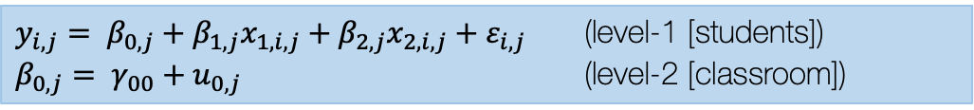
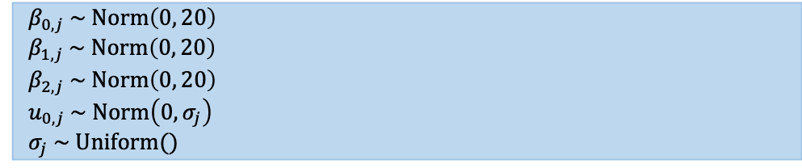
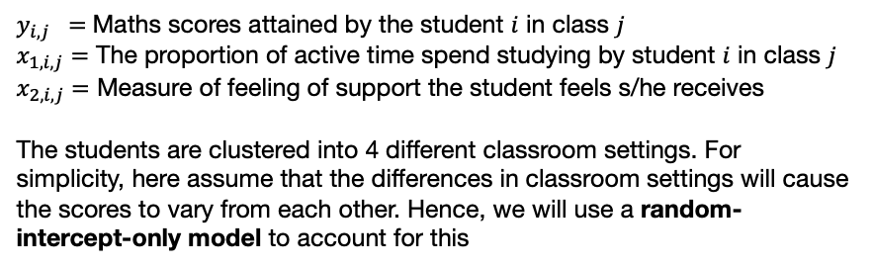
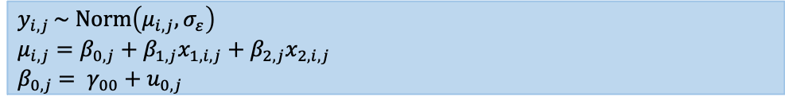
Example: Maths scores and active learning study [1]
GOAL: Assessing the impact of active learning on examine scores on mathematics among 200 school children total in 4 different class settings
Model formulation
Using a 2-level hierarchical model (random-intercept-only
$y_{i,j}= β_{0,j}+β_{1,j}x_{1,i,j}+β_{2,j}x_{2,i,j}+ε_{i,j}$ (level-1 [students])
$β_{0,j}= γ_{00}+u_{0,j}$ (level-2 [classroom])
Specify likelihood function. The outcome is continuous – thus it normal (so no link function is need here).
$y_{i,j} =$ Maths scores attained by the student $i$ in class $j$
$x_{1,i,j}=$ The proportion of active time spend studying by student $i$ in class $j$
$x_{2,i,j}=$ Measure of feeling of support the student feels s/he receives
The students are clustered into 4 different classroom settings. For simplicity, here assume that the differences in classroom settings will cause the scores to vary from each other. Hence, we will use a random-intercept-only model to account for this
$y_{i,j }\sim Norm\left(μ_{i,j}, σ_{ε}\right)$
$μ_{i,j}=β_{0,j}+β_{1,j}x_{1,i,j}+β_{2,j}x_{2,i,j}$
${ β}_{0,j} = γ_{00}+u_{0,j}$
Define the priors for the intercept, coefficients and random effects
$${ β}_{0,j} \sim Norm\left(0, 20\right)$$
$${ β}_{1,j} \sim Norm\left(0, 20\right)$$
$${ β}_{2,j} \sim Norm\left(0, 20\right)$$
${ u}_{0,j} \sim Norm\left(0,σ_{j}\right)$
$${ σ}_{j} \sim Uniform()$$
Build Bayesian model
Recall the Bayes’ Rule: $P\left(θ | Y\right)∝P\left(Y | θ\right)P(θ)$
$$P\left({β_{0,j},β_{1,j},β_{2,j},u}_{0,j} | { μ}_{i,j}\right)∝P\left({ μ}_{i,j} | {β_{0,j},β_{1,j},β_{2,j},u}_{0,j}\right) P\left(β_{0,j}\right)P\left(β_{1,j}\right)P\left(β_{2,j}\right)P(u_{0,j})$$
24

Slide 25
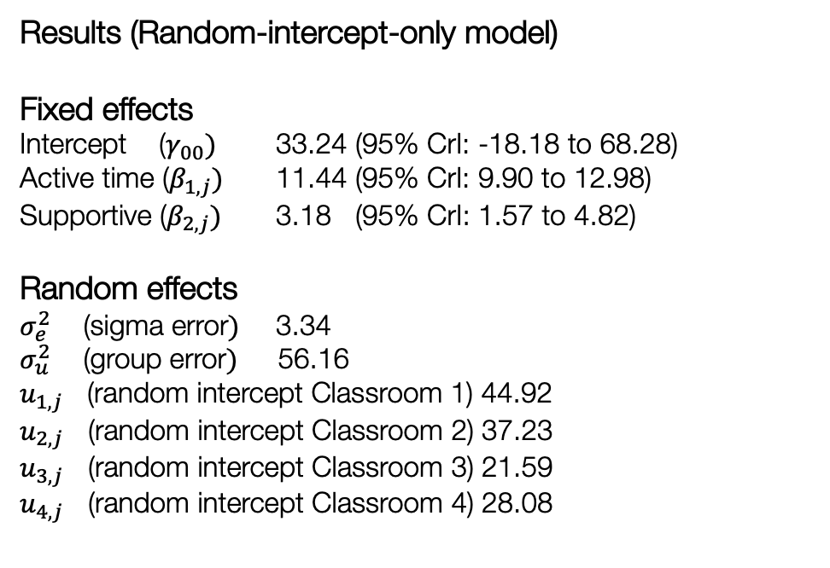
Example: Maths scores and active learning study [2]
Stan code
Results (Random-intercept-only model)
Fixed effects
Intercept ($γ_{00})$ 33.24 (95% CrI: -18.18 to 68.28)
Active time ($β_{1,j})$ 11.44 (95% CrI: 9.90 to 12.98)
Supportive ($β_{2,j})$ 3.18 (95% CrI: 1.57 to 4.82)
Random effects
$σ_{e}^{2}$ (sigma error$)$ 3.34
$σ_{u}^{2}$ (group error$)$ 56.16
$u_{1,j}$ (random intercept Classroom 1) 44.92
$u_{2,j}$ (random intercept Classroom 2) 37.23
$u_{3,j}$ (random intercept Classroom 3) 21.59
$u_{4,j}$ (random intercept Classroom 4) 28.08
data {
int<lower = 0> N;
int<lower = 0> CL;
int<lower = 0, upper = CL> ClassroomID[N];
int<lower = 0> k;
real<lower = 0> ActiveTime[N];
real<lower = 0> Supportive[N];
real<lower = 0> MathScore[N];
}
parameters {
real gamma00;
vector[k] beta;
vector[CL] u;
real<lower = 0> sigma_error;
real<lower = 0> group_error;
}
model {
real mu;
u ~ normal(0, group_error);
gamma00 ~ normal(0, 20);
beta ~ normal(0, 20);
for (i in 1:N) {
mu = gamma00 + u[ClassroomID[i]] + beta[1]*ActiveTime[i] + beta[2]*Supportive[i];
MathScore[i] ~ normal(mu, sigma_error);
}
}
25

Slide 26





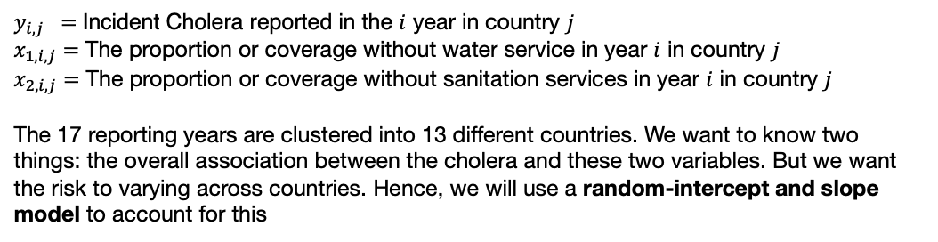


Example: Assessing the impact of water and sanitation provision on Cholera burden in Sub-Saharan Africa [1]
GOAL: Find the association between limited water and sanitation services (%) with incident Cholera (2000-2017) across 13 countries
$y_{i,j} =$ Incident Cholera reported in the $i$ year in country $j$
$x_{1,i,j}=$ The proportion or coverage without water service in year $i$ in country $j$
$x_{2,i,j}=$ The proportion or coverage without sanitation services in year $i$ in country $j$
The 17 reporting years are clustered into 13 different countries. We want to know two things: the overall association between the cholera and these two variables. But we want the risk to varying across countries. Hence, we will use a random-intercept and slope model to account for this
Country information (level-2)
Country 1
Country 2
Country 3
Country $j$
$$⋯$$
1
2
3
$$⋯$$
$$i$$
1
2
3
$$⋯$$
$$i$$
1
2
3
$$⋯$$
$$i$$
1
2
3
$$⋯$$
$$i$$
WHO Reporting year information (level-1)

Slide 27

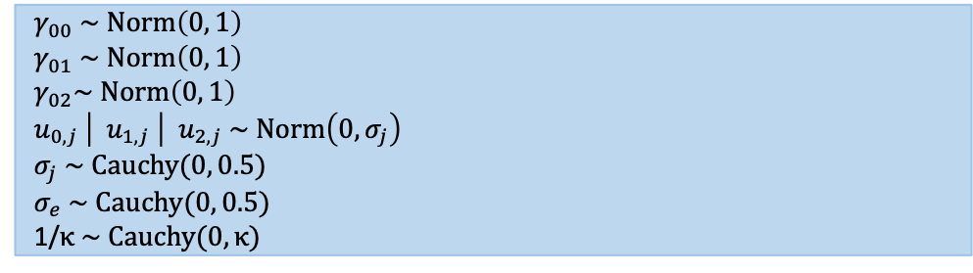
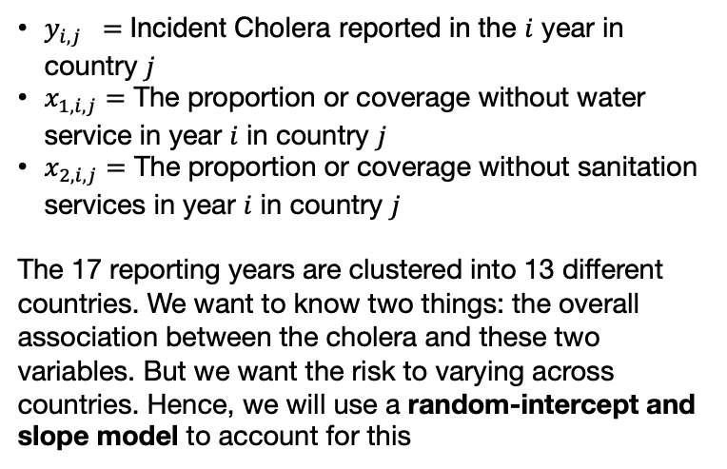

Information
Model formulation
Using a 2-level hierarchical model (random-intercept-only
$y_{i,j} =$ Incident Cholera reported in the $i$ year in country $j$
$x_{1,i,j}=$ The proportion or coverage without water service in year $i$ in country $j$
$x_{2,i,j}=$ The proportion or coverage without sanitation services in year $i$ in country $j$
The 17 reporting years are clustered into 13 different countries. We want to know two things: the overall association between the cholera and these two variables. But we want the risk to varying across countries. Hence, we will use a random-intercept and slope model to account for this
$$y_{i,j}= β_{0,j}+β_{1,j}x_{1,i,j}+β_{2,j}x_{2,i,j}+\log\left(p_{i,j}\right)$$
$$β_{0,j}= γ_{00}+u_{0,j}$$
intercept varies across countries (level-2)
$$β_{1,j}= γ_{01}+u_{1,j}$$
water varies across countries (level-2)
$$β_{2,j}= γ_{02}+u_{2,j}$$
sanitation varies across countries (level-2)
Specify likelihood function. The outcome is continuous – thus it normal (so no link function is need here).
$y_{i,j }\sim Negbin\left(μ_{i,j}, κ\right)$
$μ_{i,j}=β_{0,j}+β_{1,j}x_{1,i,j}+β_{2,j}x_{2,i,j}$ $+\log\left(p_{i,j}\right)$
Define the priors for the intercept, coefficients and random effects
$${ γ}_{00} \sim Norm\left(0, 1\right)$$
$${ γ}_{01} \sim Norm\left(0, 1\right)$$
$${ γ}_{02}\sim Norm\left(0, 1\right)$$
${ u}_{0,j} \left|{ u}_{1,j} \right|{ u}_{2,j} \sim Norm\left(0,σ_{j}\right)$
$${ σ}_{j} \sim Cauchy(0, 0.5)$$
$${ σ}_{e} \sim Cauchy(0, 0.5)$$
1/$κ \sim Cauchy(0,κ)$
Build Bayesian model
Recall the Bayes’ Rule: $P\left(θ | Y\right)∝P\left(Y | θ\right)P(θ)$
$$P\left({β_{0,j},β_{1,j},β_{2,j},u}_{0,j} | { μ}_{i,j}\right)∝P\left({ μ}_{i,j} | {β_{0,j},β_{1,j},β_{2,j},u}_{0,j}\right) P\left(β_{0,j}\right)P\left(β_{1,j}\right)P\left(β_{2,j}\right)P(u_{0,j})$$

Slide 28
Part 1
Part 2
data {
int<lower=0> N;
int<lower=0> Country;
int<lower=0, upper=Country> CountryID[N];
int<lower=0> Cholera[N];
real Water[N];
real Sanitation[N];
real Population[N];
real Kappa; // Overdispersion value = 0.4
}
model {
random_effect ~ normal(0, group_error);
gamma00 ~ normal(0, 1);
gamma01 ~ normal(0, 1);
gamma02 ~ normal(0, 1);
group_error ~ cauchy(0, 0.5);
sigma_error ~ cauchy(0, 0.5);
reciporcal_phi ~ cauchy(0, Kappa);
for (i in 1:N){
Cholera[i] ~ neg_binomial_2_log(beta00[CountryID[i]] + beta01[CountryID[i]]*Water[i] + beta02[CountryID[i]]*Sanitation[i] + Population[i], phi);
}
}
parameters {
real gamma00; // overall intercept
real gamma01; // overall relationship with water
real gamma02; // overall relationship with sanitation
real random_effect[Country];
real<lower=0> sigma_error;
real<lower=0> group_error;
real reciporcal_phi;
}
transformed parameters {
real beta00[Country];
for (j in 1:Country) {
beta00[j] = gamma00 + random_effect[j];
}
real beta01[Country];
for (j in 1:Country){
beta01[j] = gamma01 + random_effect[j];
}
real beta02[Country];
for (j in 1:Country){
beta02[j] = gamma02 + random_effect[j];
}
real phi;
phi = 1./reciporcal_phi;
}

Slide 29
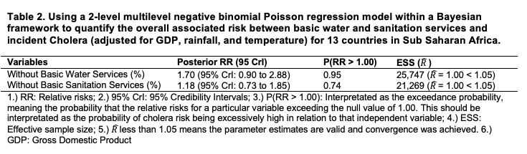
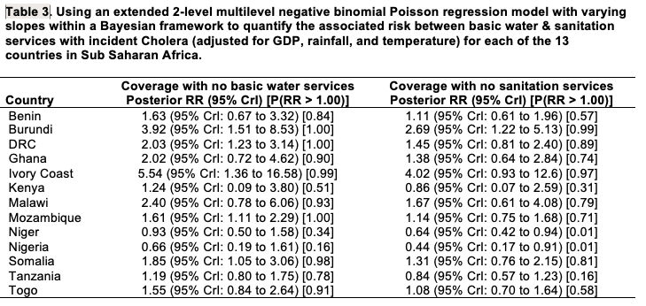




$${ γ}_{01}$$
$${ γ}_{02}$$
$$β_{1,j}$$
$$β_{2,j}$$

Slide 30
Any questions?
30

